Slide 1
A COMPARITIVE STUDY ON PREDICTION AND DIAGNOSIS OF DIABETES
Aroosa Sawati

Slide 2
Project Outline
Basic exploration and cleaning up
Useful and informative plots
Probabilistic analysis
Predicting diabetes using algorithms
Model Evaluation

Slide 3

This project deals with the comparative and predictive analysis of diabetes using machine learning concepts and algorithms.
Using machine learning concepts, the model has been created based on a pre-defined dataset based on insulin level, BMI, skin type and so on.
The dataset is classified into training and testing datasets. The training input and output datasets are expected to create the model.
The testing inputs datasets are then used for predicting the outcome of the model, which is then compared to testing output datasets.
The following machine learning models have been used for the comparative study:
Logistic Regression
Support Vector Machine
KNN
Random Forest
About
the
Project

Slide 4
Across the globe there is a necessity of regional studies for diabetes prediction. If an early diagnosis is done, then these results can be very helpful to reduce the number of treatments a patient has to undergo during late diagnosis of the patient.
The patient can control their diet accordingly and appropriate measures can be taken before hand.
Theoretically, this project aims in bringing the analysis reports of several supervised learning algorithms such as KNN, Logistic Regression, Random Forest.

Slide 5

DATA ACQUISTION
The data is acquired in a csv format from :
https://www.kaggle.com/uciml/pima-indians-diabetes-database
The dataset consists of several medical predictor(independent) variables and one target (dependent) variable , Outcome. Independent variable includes the patients BMI, insulin level age ands so on.
DATA CLEANING
The redundant information is removed from data in pandas. Unwanted observation in the dataset are duplicate information and irrelevant information.
DATA PREPROCESSING
Data pre-processing is like transforming the data before feeding the data to a machine learning algorithm. It is basically converting the data from raw format into clean data
About the Dataset

Slide 6
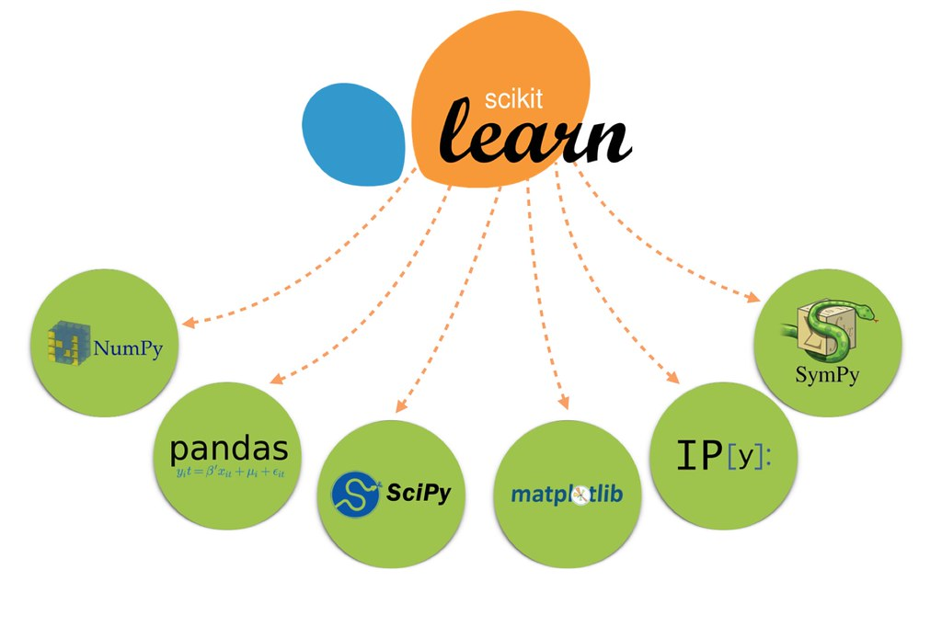




Technology Used

Slide 7
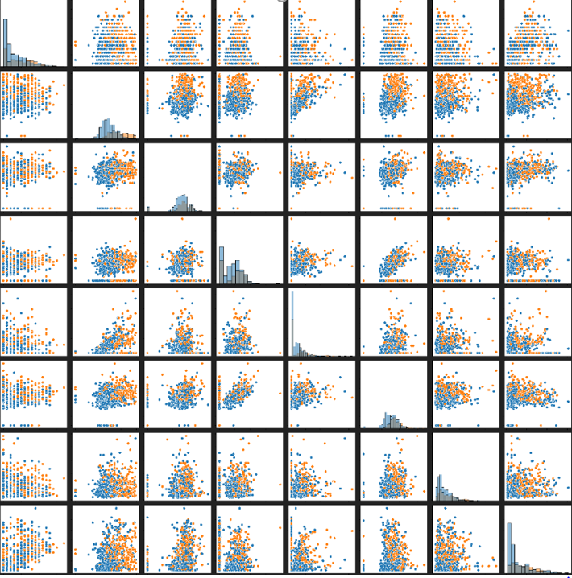
Scatter Matrix
This scatter plot gives us the histogram for the distributions along the diagonal and a lot of 2D scatter plots off-diagonal.
Some variables have a lot of scatter and some are correlated i.e. there is a direction in their scatter which leads us to correlation plots.

Slide 8
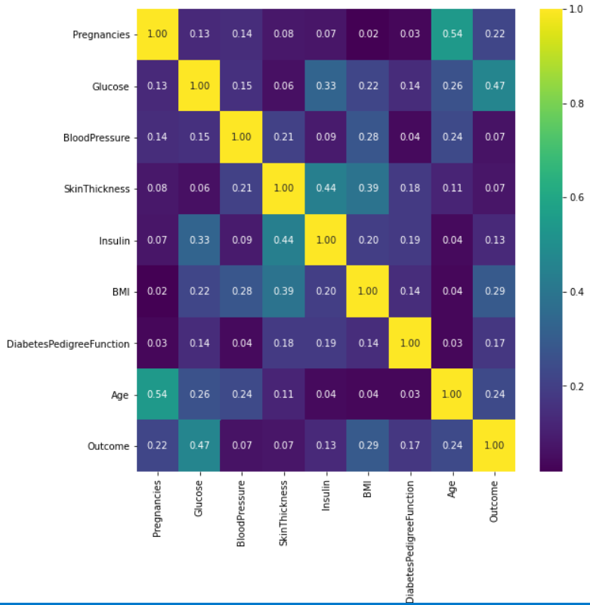
Correlation Heatmap
Correlation ranges from -1 to +1.
Values closer to zero means there is no linear trend between the two variables.
The values closer to 1 indicate positive correlation between the variables.

Slide 9
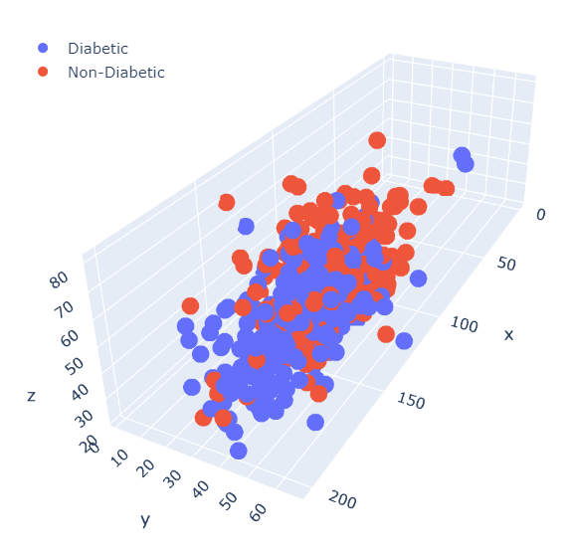
Probabilistic Analysis
(3D image of Diabetic and Non-diabetic Individuals)
To have a probabilistic analysis of our data, a simple approach might be just to use the top correlated variables and investigate them further.
In our case we have selected Glucose (x) , BMI (y) and Age (z).
'Pregnancies' are not included because we are not paying attention to gender.
The figure shows a 3D scatter plot for diabetic and non-diabetic patients. The red dots indicate non-diabetic individuals whereas the blue dots indicates diabetic individuals.
It's hard to separate the dots even if you look from different angles.

Slide 10
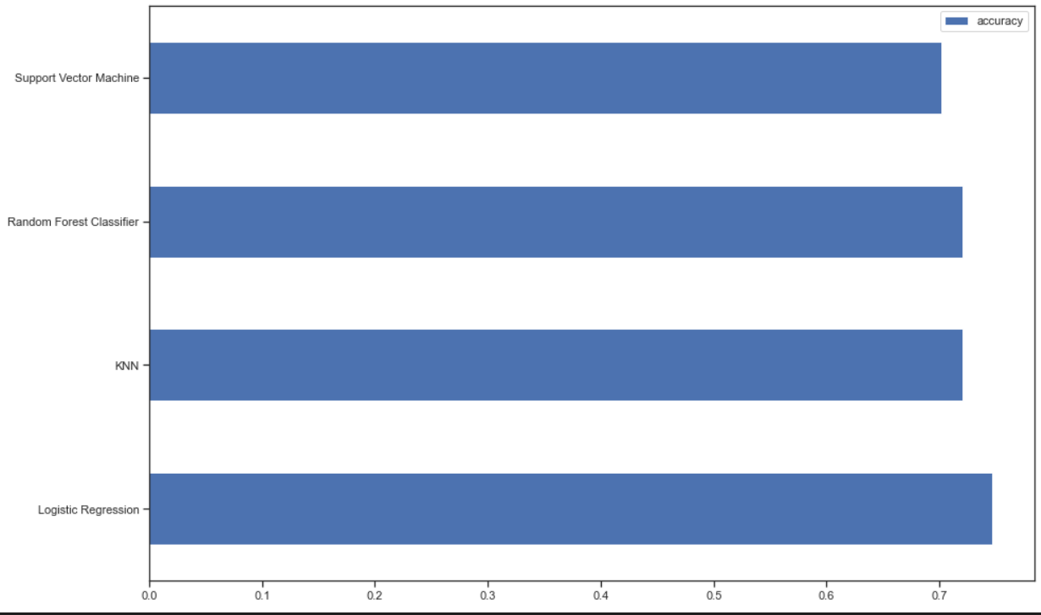
Visualizing the
training performance of all models
Support Vector Machine
Random forest Classifier
KNN(k-nearest neighbors)
Logistic regression

Slide 11
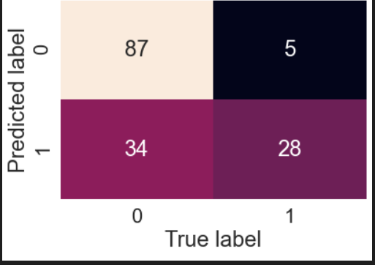
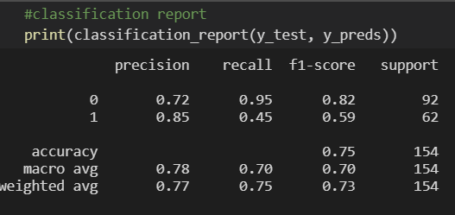
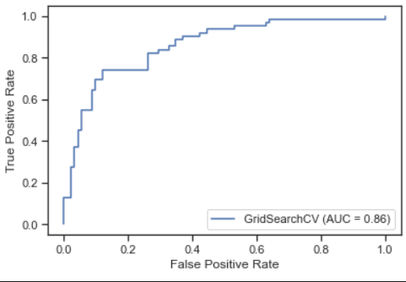
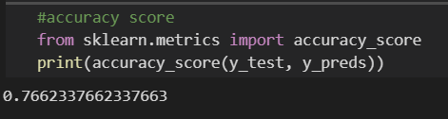
Model Evaluation
Confusion Matrix
Classification Report
ROC
Accuracy score

Slide 12
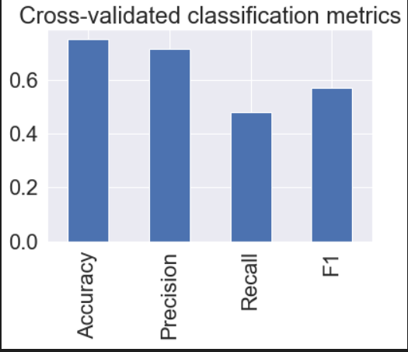
Model Evaluation
Cross validated precision, accuracy, recall, f1-score

Slide 13
DEMO
https://aroosa-github.github.io/Final-Project/

Slide 14

Conclusion
In this project our aim is to diagnose diabetes with maximum accuracy using several supervised learning algorithms. Algorithms such as Logistic Regression, KNN, Random Forrest , Support Vector Machine.
Logistic regression is found out to be the most accurate algorithm in the prediction of diabetes
The analysis finally results in bringing Logistic Regression with 75% and KNN with 72%.

Slide 15
Questions?

Slide 16
References
https://diabetesatlas.org/data/en/world/
https://www.kaggle.com/uciml/pima-indians-diabetes-database
http://data.worldbank.org/data-catalog/world-development-indicators

